Slide 1





Federal Health Information Modeling and Standards (FHIMS) Work Group
Mitra Rocca - Co-chair, Government Projects WG
Steve Wagner - Program Manager, FHA FHIMS WG
Oct 05, 2010
© 2002-2010 Health Level Seven ®, Inc. All Rights Reserved. HL7 and Health Level Seven are registered trademarks of Health Level Seven, Inc. Reg. U.S. Pat & TM Off

Slide 2
Work Group
Vision & Goals
Support the Federal Health Architecture (FHA)
eGov Initiative
  To effectively use information technology to improve the safety, quality and efficiency of health and healthcare for all Americans
Establish the Federal Health Interoperability
Modeling & Standards (FHIMS) Work Group as part of an overall FHA Standards Program
  Program Manager: Steve Wagner (ONC/FHA)
Establish an Information Modeling Project to produce a unified Federal Health Information Model (FHIM) harmonized across Federal Agencies and Standards Developing Organizations
  UML Domain Models
  Definitions, Standards, & Value Sets
© 2002-2010 Health Level Seven ®, Inc. All Rights Reserved. HL7 and Health Level Seven are registered trademarks of Health Level Seven, Inc. Reg. U.S. Pat & TM Off
3

Slide 3
Participants
Steering Group Members:
  DoD [Nancy Orvis]
  SSA [Justine Piereman]
  CDC [Nikolay Lipskiy]
  VHA [Tim Cromwell]
  NCI [George Komatsoulis]
  CMS [Theresa Lissauer]
Information Modeling Project comprised of volunteers from:
DoD / MHS | CDC
VA / VHA | SSA
HHS | SAMHSA
CMS | IHS
FDA | NCI
NLM | FHA
All are encouraged to invite Subject Matter Experts (SMEs) from their respective organizations to provide insight and input on models, standards, and definitions.
© 2002-2010 Health Level Seven ®, Inc. All Rights Reserved. HL7 and Health Level Seven are registered trademarks of Health Level Seven, Inc. Reg. U.S. Pat & TM Off
4

Slide 4
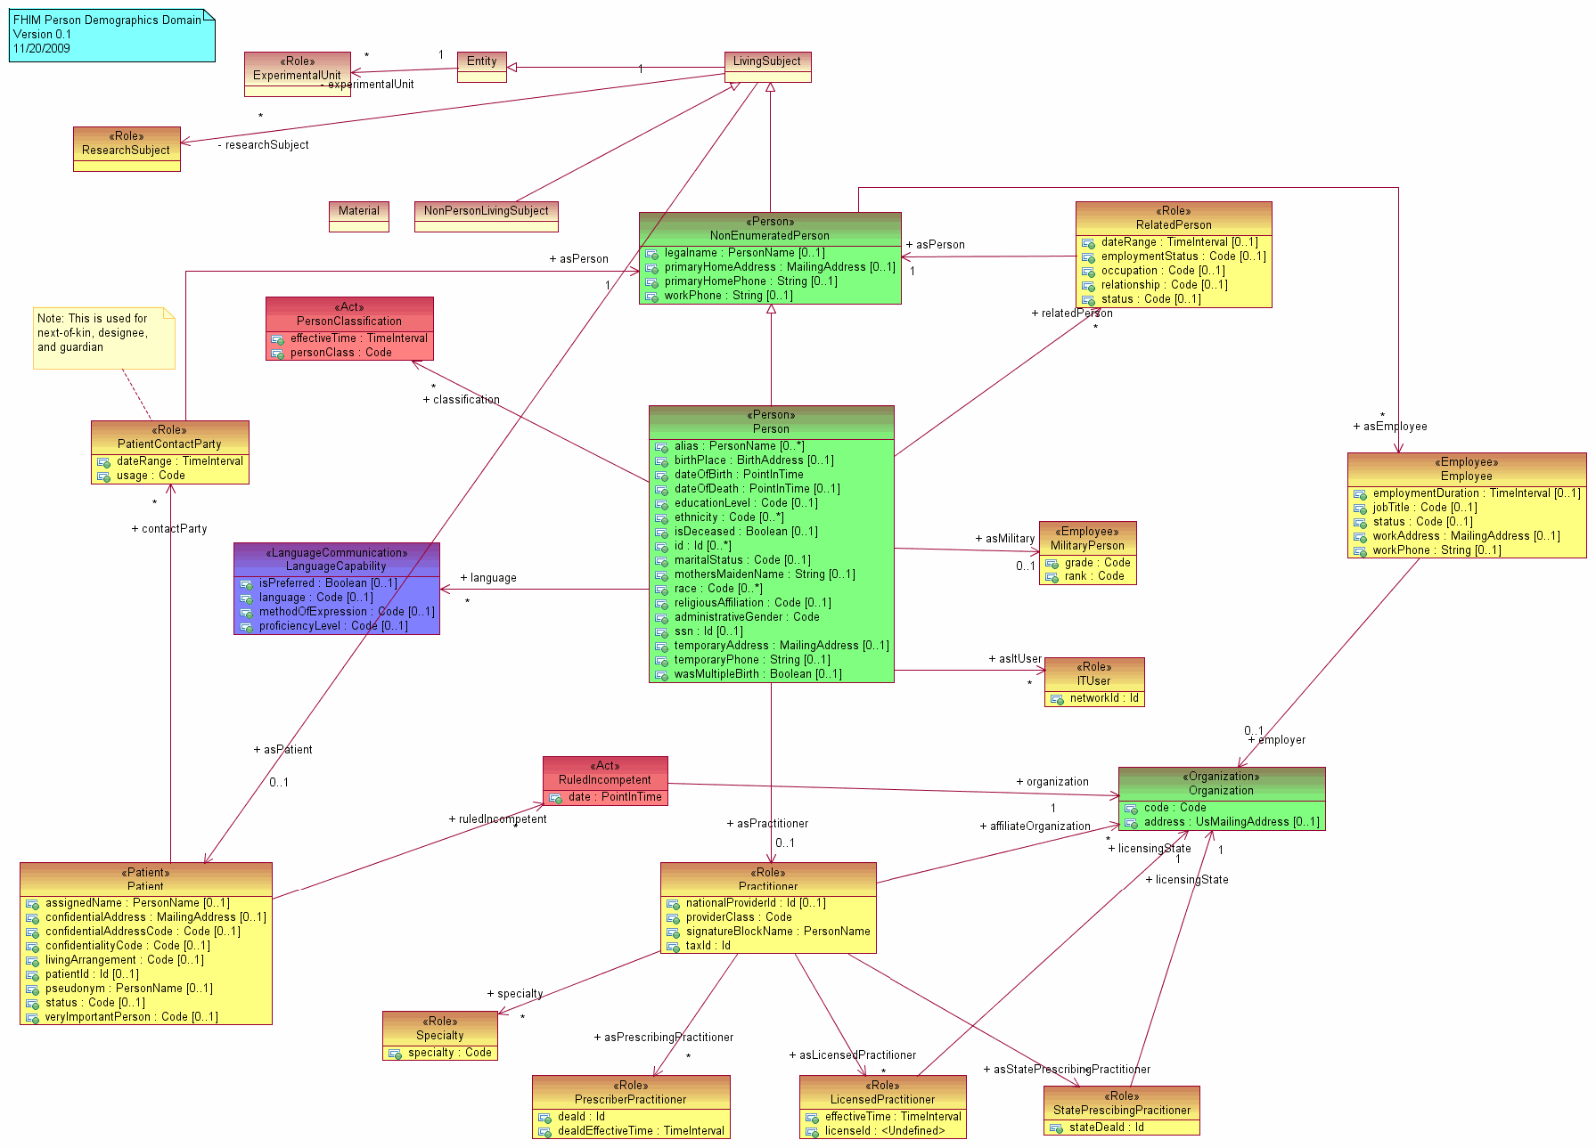
Action Plan
Information Model
  Develop a logical, UML based, health information model
Terminology Models
  Develop terminology
models/value sets in
conjunction with and
in support of the information model
Implementation Models
  Integrate information and terminology models with Open Health Tools open source implementation modeling tools
© 2002-2010 Health Level Seven ®, Inc. All Rights Reserved. HL7 and Health Level Seven are registered trademarks of Health Level Seven, Inc. Reg. U.S. Pat & TM Off
5

Slide 5
Modeling Approach
Sept 2009
Nov 2009
Dec 2009
Jan 2010 … ongoing…
Draft
Models /
Document
Concepts
& codes
Provide
Models, Specs,
Definitions to SDOs & Agencies
Define
Strategy
Define
Modeling
Process
Define
Style
Guide/
Tools
Vet
Model &
Concepts
Generate
Interoperability
Specifications
Gather
Participants
Establish
Workgroups
Harmonize
Feedback
Repeats for each domain
Create a baseline model from existing VA, NCI and FDA models
Use the HL7 RIM as a reference model
Harmonize information across the FHA Federal Partners/Agencies
Harmonize with information defined by health SDOs and HITSP
Identify concepts and terminologies in need of harmonization
Fully document coded data attributes and their value sets
Vet model, terminologies/value sets and definitions with FHA Federal Partners/Agencies and harmonize final comments
Use model driven architecture approach to produce interoperability specifications
Integrate model approach and content into existing SDO development processes
Interoperability specifications available for FHA Partners/Agencies to leverage
© 2002-2010 Health Level Seven ®, Inc. All Rights Reserved. HL7 and Health Level Seven are registered trademarks of Health Level Seven, Inc. Reg. U.S. Pat & TM Off
6

Slide 6
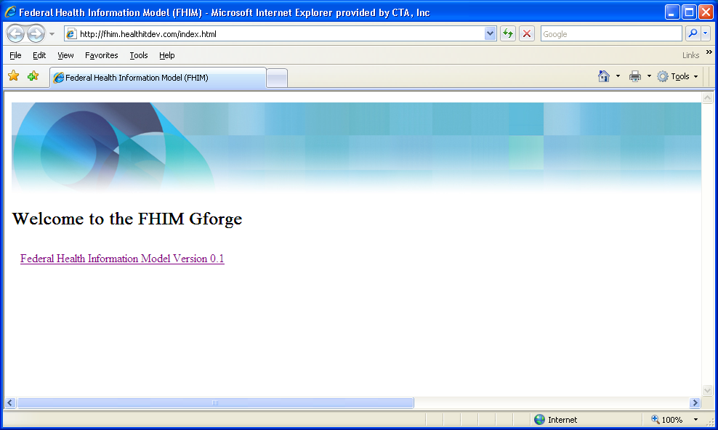
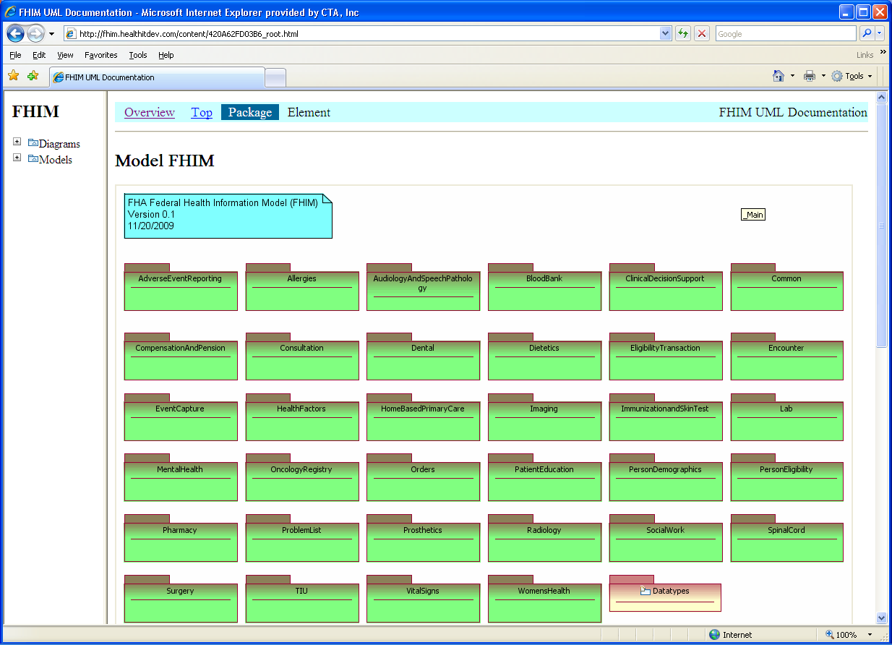
FHIM
Website
© 2002-2010 Health Level Seven ®, Inc. All Rights Reserved. HL7 and Health Level Seven are registered trademarks of Health Level Seven, Inc. Reg. U.S. Pat & TM Off
5

Slide 7
Accomplishments
Development of UML models & class definitions for:
Person Demographics
Security & Privacy
Behavioral Health
Enrollment Eligibility Coordination of
Benefits
Medication Management/Pharmacy
Laboratory Domain
© 2002-2010 Health Level Seven ®, Inc. All Rights Reserved. HL7 and Health Level Seven are registered trademarks of Health Level Seven, Inc. Reg. U.S. Pat & TM Off
5

Slide 8
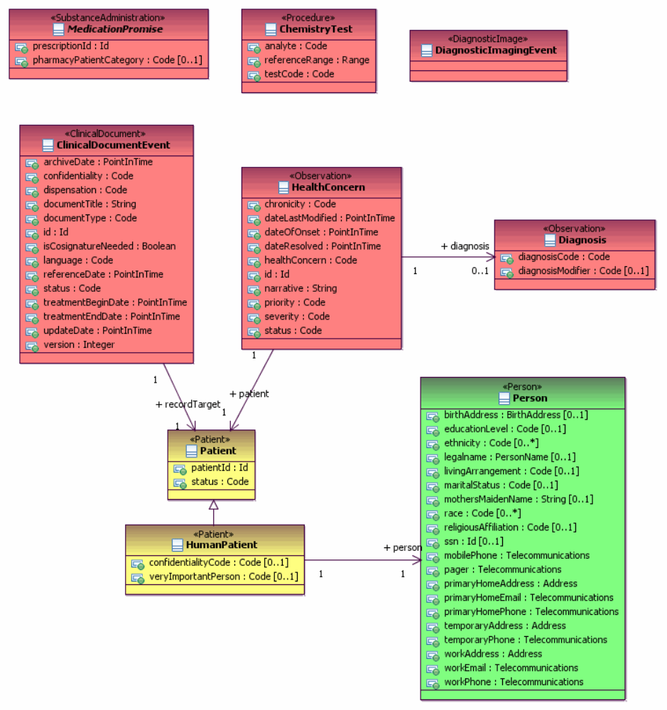
Example UML Domain Model : Person Demographic
© 2002-2010 Health Level Seven ®, Inc. All Rights Reserved. HL7 and Health Level Seven are registered trademarks of Health Level Seven, Inc. Reg. U.S. Pat & TM Off
5

Slide 9
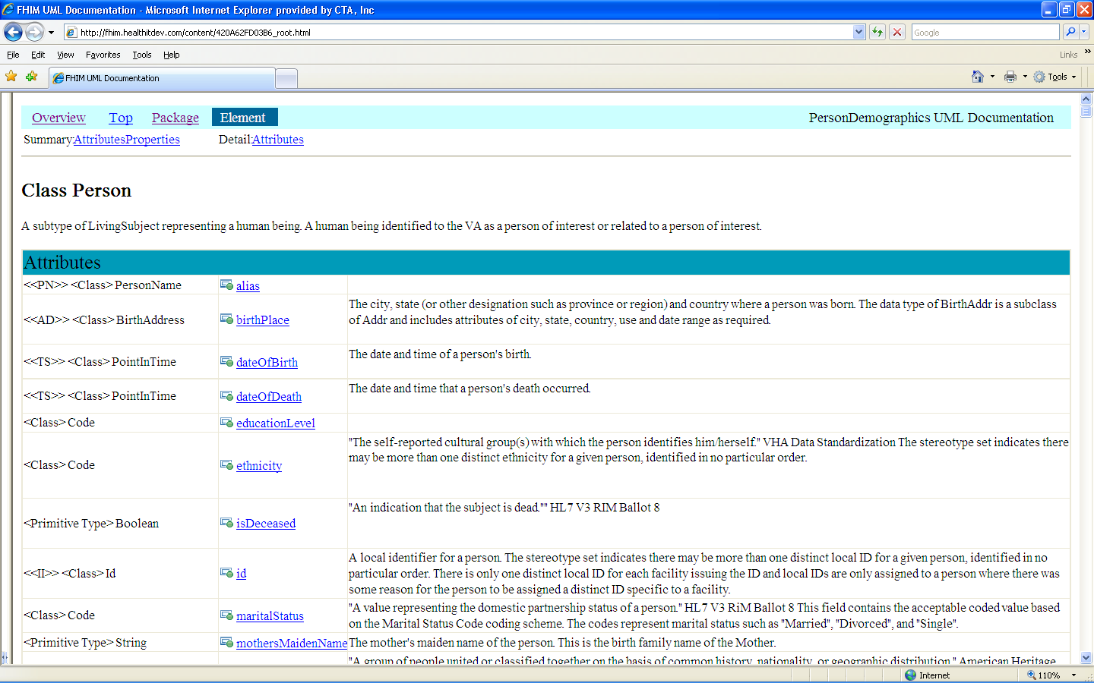
Example: Class Documentation / Definition
© 2002-2010 Health Level Seven ®, Inc. All Rights Reserved. HL7 and Health Level Seven are registered trademarks of Health Level Seven, Inc. Reg. U.S. Pat & TM Off
5

Slide 10
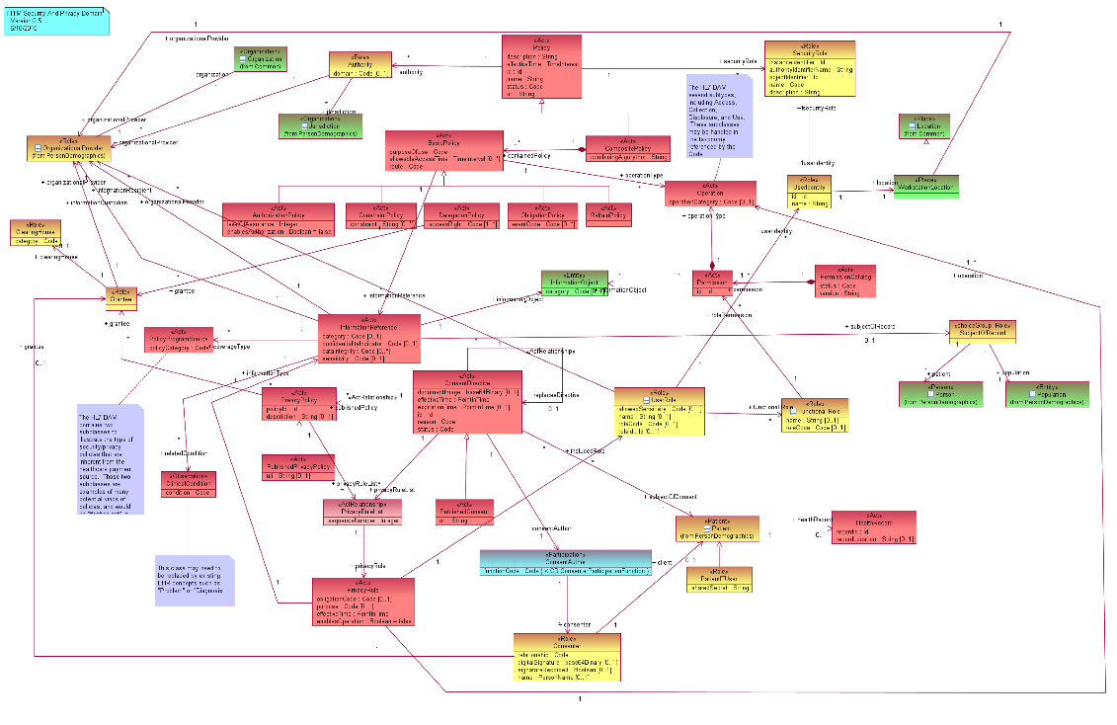
Example UML Domain:
Security & Privacy
© 2002-2010 Health Level Seven ®, Inc. All Rights Reserved. HL7 and Health Level Seven are registered trademarks of Health Level Seven, Inc. Reg. U.S. Pat & TM Off
5

Slide 11
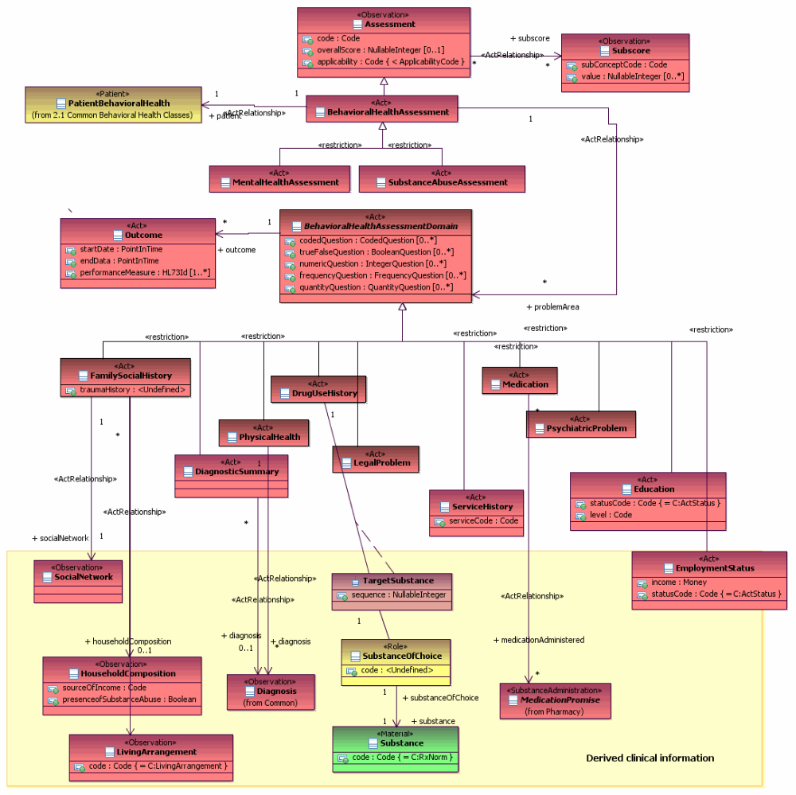
Example UML Domain:
Behavioral Health
© 2002-2010 Health Level Seven ®, Inc. All Rights Reserved. HL7 and Health Level Seven are registered trademarks of Health Level Seven, Inc. Reg. U.S. Pat & TM Off
5

Slide 12
FHIMS Behavioral Health Workgroup
Aditya Naik – Chair
Ioana Singureanu (Lead Modeler)
Steve Wagner - Program Manager, FHA FHIMS WG
Formed on: 12 July 2010
© 2002-2010 Health Level Seven ®, Inc. All Rights Reserved. HL7 and Health Level Seven are registered trademarks of Health Level Seven, Inc. Reg. U.S. Pat & TM Off

Slide 13
Behavioral Health Work Group Vision & Goals
Produce a refined Federal Health Information Model (FHIM) to purpose of this model is to describe the main information required to support continuity of care across specialties including information to and from behavioral health facilities.
This model describes the information and the most important coded concepts required for semantic interoperability regardless of platform or exchange mechanism (e.g. HL7 CDA, ASTM, NIEM).
Produce a model that is harmonized across Federal government agencies and across existing standards
Support the Federal Health Architecture (FHA) FHIMS project
© 2002-2010 Health Level Seven ®, Inc. All Rights Reserved. HL7 and Health Level Seven are registered trademarks of Health Level Seven, Inc. Reg. U.S. Pat & TM Off
5

Slide 14
Process
Review existing standards, artifacts in use by various fed. Government agencies
Develop models with focus on various areas of medication management:
  Use case models
  Review HL7 RIM
  Review FHIM Core classes and re-use them where appropriate
  Bind to controlled terminologies (SNOMED CT, …)
© 2002-2010 Health Level Seven ®, Inc. All Rights Reserved. HL7 and Health Level Seven are registered trademarks of Health Level Seven, Inc. Reg. U.S. Pat & TM Off
5

Slide 15
Members
Ioana Singureanu (Lead Modeler) Steve Wagner (ONC/FHA, FHIMS Workgroup Program Manager) Robert Crawford (VA) Aditya Naik (SSA) Kathleen Keats (IHS) Danny Davis (DoD) Kesarinath, Gautam (CDC) | Steve Hufnagel (DoD) John McKim (CTA) Sean Muir (VA) Rob McClure (Apelon) Michael Lincoln (VA) Andrew Regiec (CTA) Jay Lyle (VA)
Add other members of the team
© 2002-2010 Health Level Seven ®, Inc. All Rights Reserved. HL7 and Health Level Seven are registered trademarks of Health Level Seven, Inc. Reg. U.S. Pat & TM Off
5

Slide 16
Deliverables
Developed Behavioral health use case models, class diagrams integrated with the rest of the FHIM
Definitions, standards and value sets needed for this domain were defined
© 2002-2010 Health Level Seven ®, Inc. All Rights Reserved. HL7 and Health Level Seven are registered trademarks of Health Level Seven, Inc. Reg. U.S. Pat & TM Off
5

Slide 17
FHIMS Medication Management/Pharmacy Workgroup
Mitra Rocca – Chair
Galen Mulrooney (Lead Modeler)
Steve Wagner - Program Manager, FHA FHIMS WG
Formed on: 12 July 2010
© 2002-2010 Health Level Seven ®, Inc. All Rights Reserved. HL7 and Health Level Seven are registered trademarks of Health Level Seven, Inc. Reg. U.S. Pat & TM Off

Slide 18
Medication Management/pharmacy Work Group Vision & Goals
Produce a refined Federal Health Information Model (FHIM) to capture medication management and pharmacy requirements across Federal Agencies
Produce a model that is harmonized across Federal government agencies and across existing standards
Support the Federal Health Architecture (FHA) FHIMS project
© 2002-2010 Health Level Seven ®, Inc. All Rights Reserved. HL7 and Health Level Seven are registered trademarks of Health Level Seven, Inc. Reg. U.S. Pat & TM Off
5

Slide 19
Process
Review existing standards, artifacts in use by various fed. Government agencies
Develop models with focus on various areas of medication management:
  Drugs/medical products level (SPL, CPM, BRIDG, …)
  Medication management (ePrescribing, HL7 EHR-S Functional Model, XML representation of EHR-S FM)
  Review controlled terminologies in use for this domain (RxNorm, ….)
  HITSP Pharmacy Workgroup Products (IS 107, IS 103)
  CDC Coding vaccines and HL7 V2.5.1 IG (CVX, MVX codes)
  PHER DAM
  VHIM Model
© 2002-2010 Health Level Seven ®, Inc. All Rights Reserved. HL7 and Health Level Seven are registered trademarks of Health Level Seven, Inc. Reg. U.S. Pat & TM Off
5

Slide 20
Members
Mitra Rocca (FDA, Chair) Galen Mulrooney (VA, Lead Modeler) Steve Wagner (ONC/FHA, FHIMS Workgroup Program Manager) John Kilbourne (NLM) Lise Stevens (FDA) William Hess (FDA) Larry Callahan (FDA) Phil Perruci (FDA) Kosta Makrodimitris (FDA) Patricia Bosley (FDA) Robert Crawford (VA) Steven Sandberg (NCI) | Steve Hufnagel (DoD) John McKim (CTA) Sean Muir (VA) Rob McClure (Apelon) Michael Lincoln (VA) Andrew Regiec (CTA) Jay Lyle (VA) Kathleen Keats (IHS) Mary Jarquin (VA, Harris) Lynn Sanders (VA) Patsy Barnett (VA) Rob Savage (CDC) Tsai, Coco (FDA) LuAnne Barron (VA)
© 2002-2010 Health Level Seven ®, Inc. All Rights Reserved. HL7 and Health Level Seven are registered trademarks of Health Level Seven, Inc. Reg. U.S. Pat & TM Off
5

Slide 21
Deliverables
UML models integrated with the rest of the FHIM, for the medication management / pharmacy domain
Definitions, standards and value sets needed for this domain
© 2002-2010 Health Level Seven ®, Inc. All Rights Reserved. HL7 and Health Level Seven are registered trademarks of Health Level Seven, Inc. Reg. U.S. Pat & TM Off
5

Slide 22
FHIMS Laboratory Workgroup
Neelima Chennamaraja – Lead
Kosta Makrodimitris – Co-Lead
Galen Mulrooney (Lead Modeler)
Steve Wagner - Program Manager, FHA FHIMS WG
Formed on: 02 August 2010
© 2002-2010 Health Level Seven ®, Inc. All Rights Reserved. HL7 and Health Level Seven are registered trademarks of Health Level Seven, Inc. Reg. U.S. Pat & TM Off

Slide 23
Laboratory Work Group Vision & Goals
Produce a refined Federal Health Information Model (FHIM) to capture and prioritize different areas of lab such as clinical, research lab vs. environmental lab to ensure alignment with current standards
Produce a model that is harmonized across Federal government agencies and across existing standards
Support the Federal Health Architecture (FHA) FHIMS project
© 2002-2010 Health Level Seven ®, Inc. All Rights Reserved. HL7 and Health Level Seven are registered trademarks of Health Level Seven, Inc. Reg. U.S. Pat & TM Off
5

Slide 24
Process
Review existing standards, artifacts in use by various fed. Government agencies
Develop models with focus on various areas of medication management:
  HITSP lab use cases (General Lab Orders, EHR/Lab, Lab results, Biosurveillance, Public Health Case Reporting) , C36, C37
  HL7 V3 (O&O CMETs, …)
  AHIC Biosurveillance use case
  Certify a Pathology Laboratory for Electronic Reporting Use Case/Pathology Cancer Models
  Interoperability Specification Lab result Message_v2.5.1
© 2002-2010 Health Level Seven ®, Inc. All Rights Reserved. HL7 and Health Level Seven are registered trademarks of Health Level Seven, Inc. Reg. U.S. Pat & TM Off
5

Slide 25
Deliverables
UML models integrated with the rest of the FHIM, for the medication management / pharmacy domain
Definitions, standards and value sets needed for this domain
© 2002-2010 Health Level Seven ®, Inc. All Rights Reserved. HL7 and Health Level Seven are registered trademarks of Health Level Seven, Inc. Reg. U.S. Pat & TM Off
5

Slide 26
Members
Neelima Chennamaraja (VA) Kosta Makrodimitris (FDA) Galen Mulrooney (VA, Lead Modeler) Steve Wagner (ONC/FHA, FHIMS Workgroup Program Manager) Mitra Rocca (FDA) John McKim (CTA/MHS) Jay Lyle (VA) Sean Muir (VA) Ira Lubin (CDC) Clarence Smiley (IHS) Kathleen Keats (IHS) Minal Agrawal (CDC) Leeanne Walls (VA) Wendy Scharber (CDC) | Steve Hufnagel (DoD) Rob McClure (Apelon) Lissauer, Theresa R (CMS) Crawford, Robert C. (Booz-Allen Hamilton) Meeks, Emory L. (CDC) Kevin Puscas Mike Lincoln (VA) Jim Kretz (SAMHSA) Aditya Naik (SSA) Jennifer, Mcgehee, (CDC) Vala, Srinath (Harris) Steve Sandberg (NCI) Wendy Blumenthal (CDC) Sandy Jones (CDC)
© 2002-2010 Health Level Seven ®, Inc. All Rights Reserved. HL7 and Health Level Seven are registered trademarks of Health Level Seven, Inc. Reg. U.S. Pat & TM Off
5

Slide 27
Backup Slides
© 2002-2010 Health Level Seven ®, Inc. All Rights Reserved. HL7 and Health Level Seven are registered trademarks of Health Level Seven, Inc. Reg. U.S. Pat & TM Off

Slide 28
FHIMS EEOB Workgroup
© 2002-2010 Health Level Seven ®, Inc. All Rights Reserved. HL7 and Health Level Seven are registered trademarks of Health Level Seven, Inc. Reg. U.S. Pat & TM Off

Slide 29
FHIMS Security and Privacy Workgroup
© 2002-2010 Health Level Seven ®, Inc. All Rights Reserved. HL7 and Health Level Seven are registered trademarks of Health Level Seven, Inc. Reg. U.S. Pat & TM Off

Slide 30
Members
© 2002-2010 Health Level Seven ®, Inc. All Rights Reserved. HL7 and Health Level Seven are registered trademarks of Health Level Seven, Inc. Reg. U.S. Pat & TM Off
5

Slide 31
Members
© 2002-2010 Health Level Seven ®, Inc. All Rights Reserved. HL7 and Health Level Seven are registered trademarks of Health Level Seven, Inc. Reg. U.S. Pat & TM Off
5

Slide 32
Members
© 2002-2010 Health Level Seven ®, Inc. All Rights Reserved. HL7 and Health Level Seven are registered trademarks of Health Level Seven, Inc. Reg. U.S. Pat & TM Off
5

Slide 33
Members
© 2002-2010 Health Level Seven ®, Inc. All Rights Reserved. HL7 and Health Level Seven are registered trademarks of Health Level Seven, Inc. Reg. U.S. Pat & TM Off
5

Slide 34
Members
© 2002-2010 Health Level Seven ®, Inc. All Rights Reserved. HL7 and Health Level Seven are registered trademarks of Health Level Seven, Inc. Reg. U.S. Pat & TM Off
5

Slide 35
Members
© 2002-2010 Health Level Seven ®, Inc. All Rights Reserved. HL7 and Health Level Seven are registered trademarks of Health Level Seven, Inc. Reg. U.S. Pat & TM Off
5

Slide 36
References (1)
USHIK: United States Health Information Knowledgebase
  www.USHIK.org
HITSP: Healthcare Information Technology Standards Panel
  www.HITSP.org
HL7: Health Level 7 International
  www.HL7.org
BRIDG: Biomedical Research Integrated Domain Group
  www.bridgmodel.org
© 2002-2010 Health Level Seven ®, Inc. All Rights Reserved. HL7 and Health Level Seven are registered trademarks of Health Level Seven, Inc. Reg. U.S. Pat & TM Off
5

Slide 37
References (2)
RxNorm
  http://www.nlm.nih.gov/research/umls/rxnorm/index.html
CDC Immunization Codes
© 2002-2010 Health Level Seven ®, Inc. All Rights Reserved. HL7 and Health Level Seven are registered trademarks of Health Level Seven, Inc. Reg. U.S. Pat & TM Off
5

